Slide 1
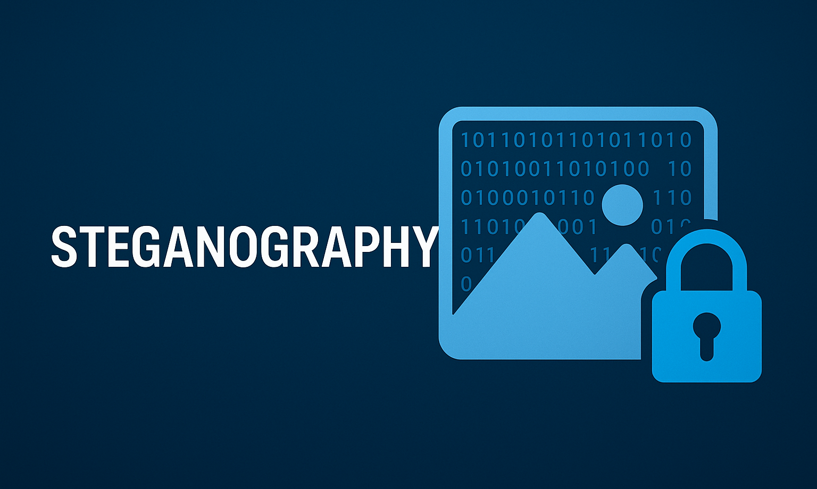
Designed by Parth Pawar

Slide 2
Executive Summary
C-based steganography tool using BMP image format and LSB encoding.
Embeds secret messages into pixel LSBs with zero visible distortion.
Provides secure message hiding and accurate extraction.
Modular, scalable, and aligned with cybersecurity-focused engineering.

Slide 3
Problem Statement
Traditional encryption appears suspicious to observers.
Need for a method that hides data invisibly within an image.
Steganography enables covert communication without raising suspicion.

Slide 4
Project Objectives
Encode text into BMP images using Least Significant Bit technique.
Decode embedded text accurately without image deterioration.
Maintain clean, modular C code architecture.
Ensure reliable file parsing and error handling.

Slide 5
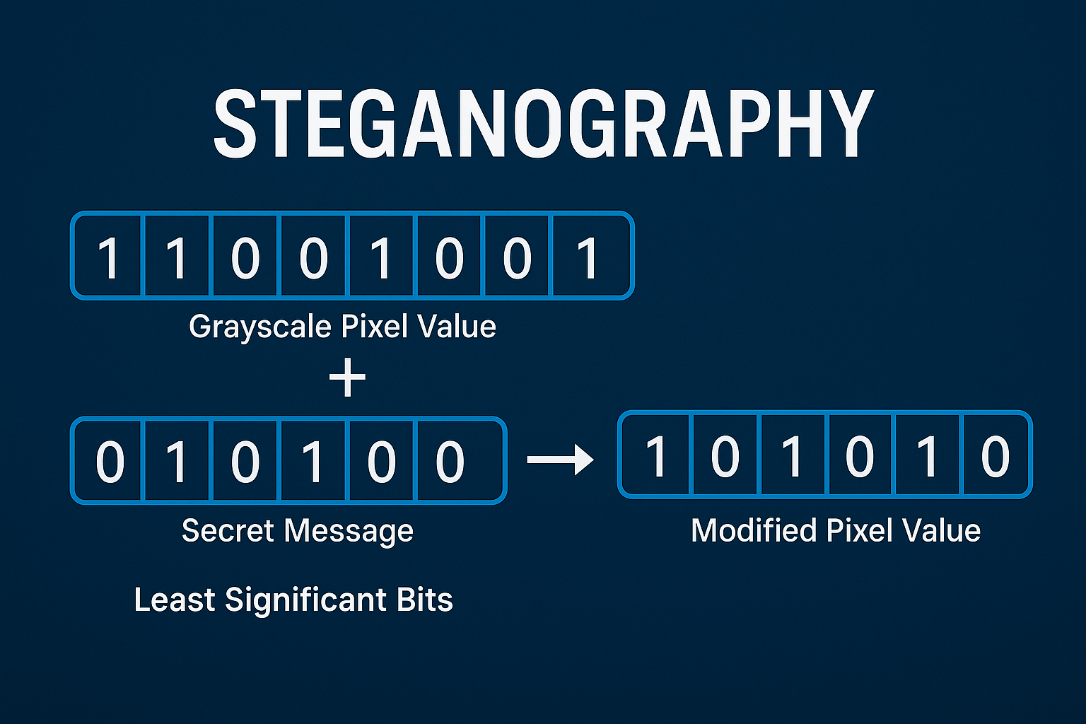

Slide 6
Flowchart
Start → Choose Encode/Decode
1
If Encode: Load BMP → Load Message → Embed → Save Output
2
If Decode: Load BMP → Extract Bits → Restore Text
3
Return to Menu or Exit
4

Slide 7
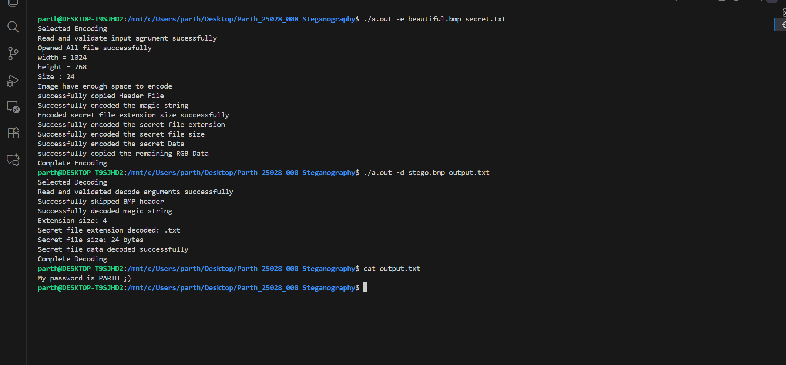
Diagram

Slide 8
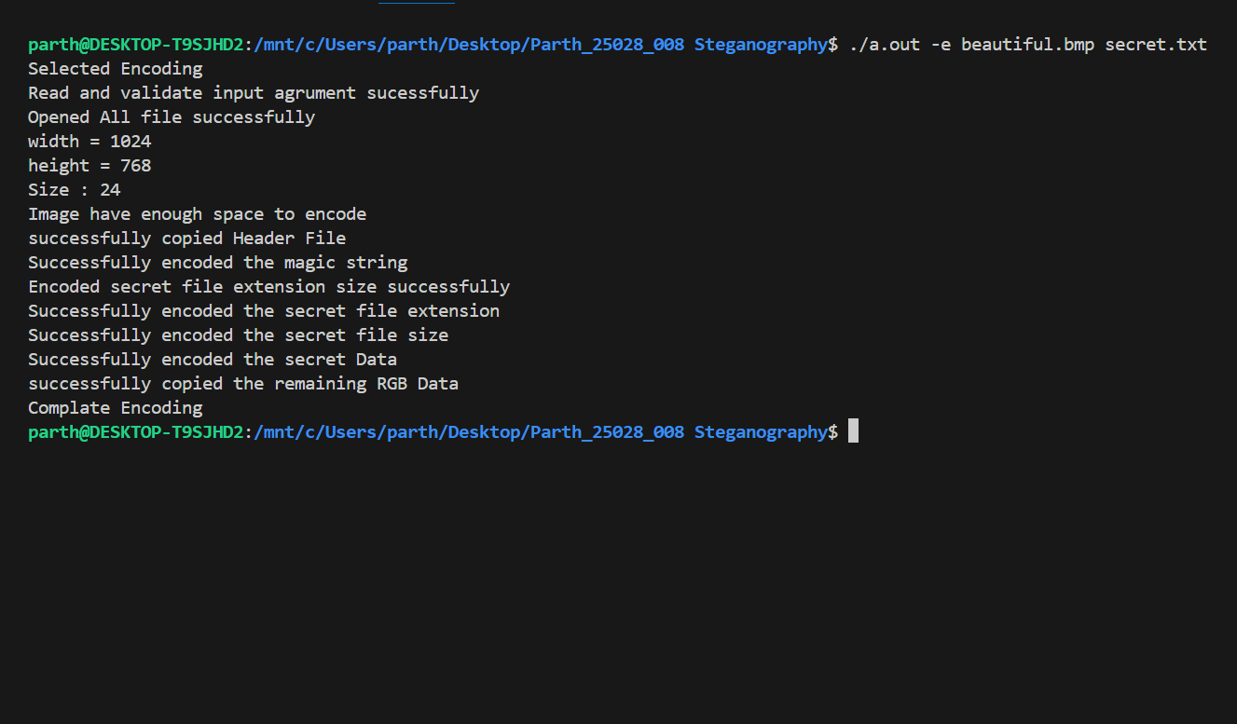
ENCODE

Slide 9

Encoded Image

Slide 10
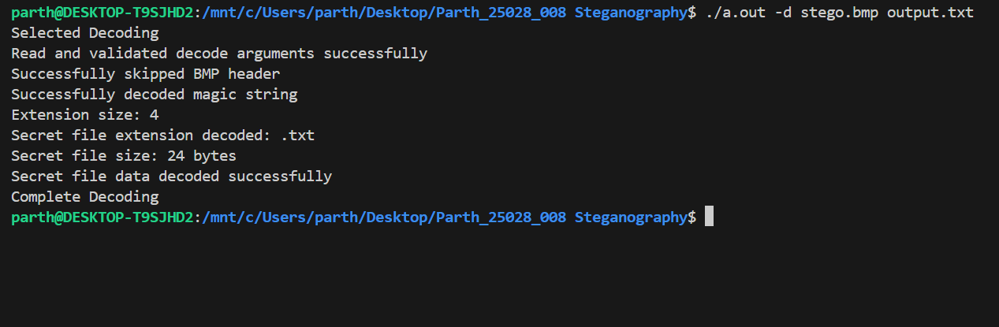
DECODE

Slide 11
Conclusion
Successfully implemented BMP-based LSB steganography in C.
Demonstrated mastery over bit manipulation and file structures.
Established strong foundation for advanced cybersecurity systems.
Project showcases engineering discipline and modular design thinking.

